Slide 1

Business Review
Atliq Hardwares
October 30, 2024
Data Analytics Team

Slide 2

Agenda
Introduction
In detailed analysis

Slide 3

Introduction
Atliq Hardwares is one of the leading computer hardware producers in India and well expanded in other countries too. Here We Analyze the performance over the period from 2019 to 2021 on different matrices.

Slide 4

Pattern Question from Management SQL Query Analysis Graph Insight on the analysis
Let’s dive in

Slide 5
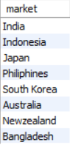
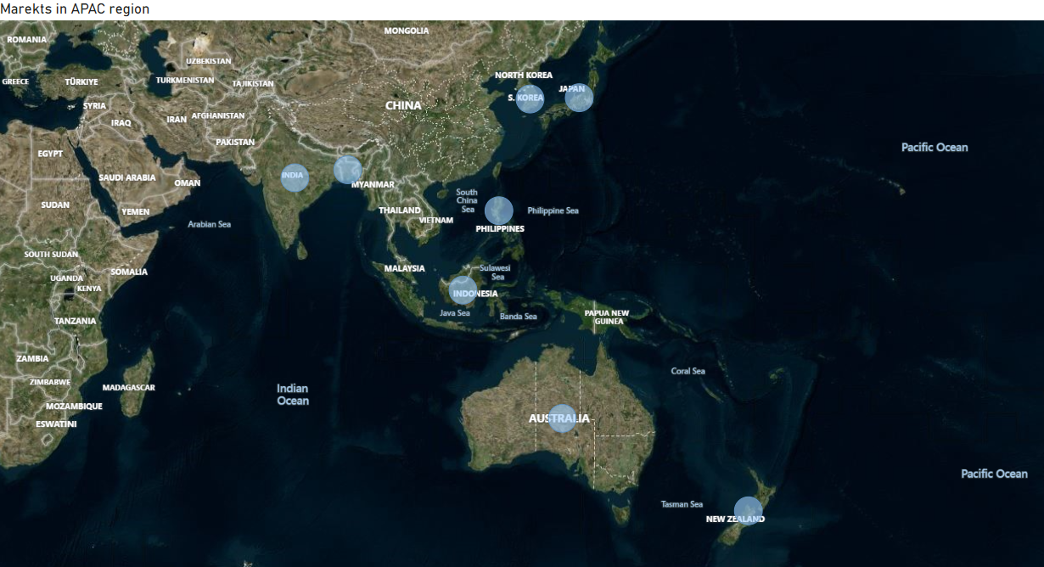
Provide the list of markets in which customer "Atliq Exclusive" operates its business in the APAC region.
#RESULT
#SQL QUERY
select distinct market from dim_customer
where customer="Atliq Exclusive" and Region="APAC";
#INSIGHT
Atliq Hardwares have market shares in 8 Countries in the APAC Region

Slide 6
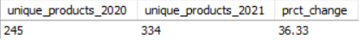
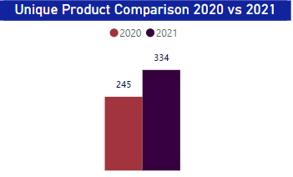
What is the percentage of unique product increase in 2021 vs. 2020? The final output contains fields, unique_products_2020 unique_products_2021 percentage_chg
#SQL QUERY
#RESULT
with pr_2020 as (select count(distinct product_code) as unique_products_2020 from fact_sales_monthlywhere fiscal_year='2020’), pr_2021 as (select count(distinct product_code) as unique_products_2021 from fact_sales_monthlywhere fiscal_year='2021’) select unique_products_2020,unique_products_2021, round(((unique_products_2021-unique_products_2020)/unique_products_2020)*100,2) as prct_change from pr_2020 cross join pr_2021;
#INSIGHT
Unique Products Increased from 245 to 334 with a %change of 36.33.
Indicates that the organisation is competitive in Market by Introducing Relevant Products and utilizing Opportunities for Business Development
The increase in unique products reflects ongoing innovation and development within the company.

Slide 7
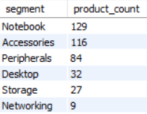
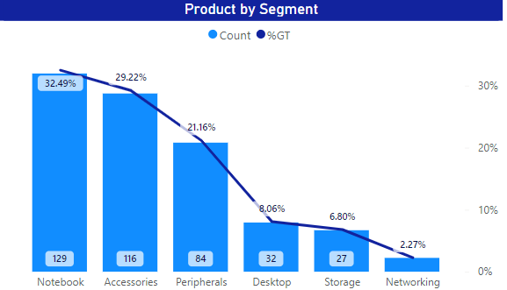
Provide a report with all the unique product counts for each segment and sort them in descending order of product counts. The final output contains, segment product_count
#SQL QUERY
#RESULT
select segment, count(distinct product_code) as product_count
from dim_product
group by segment
order by product_count desc;
#INSIGHT
Organisation is primarily focus on the Notebook, Accessories and Peripherals followed by Desktop.
Indicates that sales less lights on networking and storages.
Further focus can be on R&D on Notebooks as WFH and remote works mandates high performi- ng Notebooks and accessories.

Slide 8
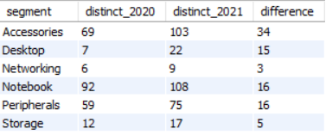
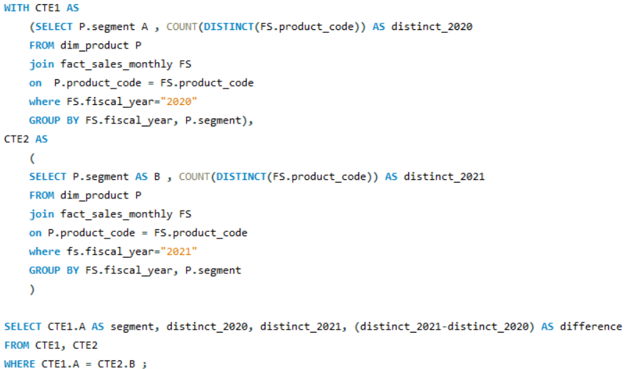
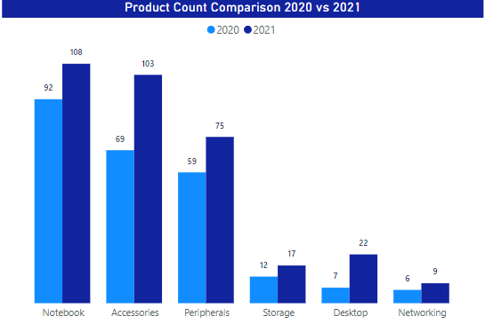
Follow-up: Which segment had the most increase in unique products in2021 vs 2020? The final output contains segment product_count_2020 product_count_2021 difference
#SQL QUERY
#RESULT
#INSIGHT
Accessories count has increased by 34 followed by Desktop, Note book and Peripherals
Which further concrete that company focuses R&D and sales on these categories- to take the competetive advantage of these categories.

Slide 9
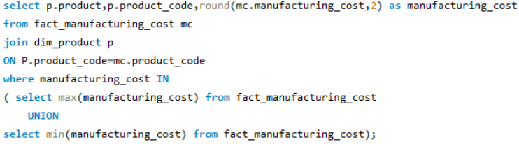
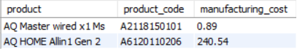
Get the products that have the highest and lowest manufacturing costs.The final output should contain these fields, product_code product manufacturing_cost
#SQL QUERY
#RESULT

Slide 10
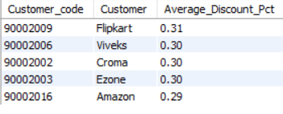
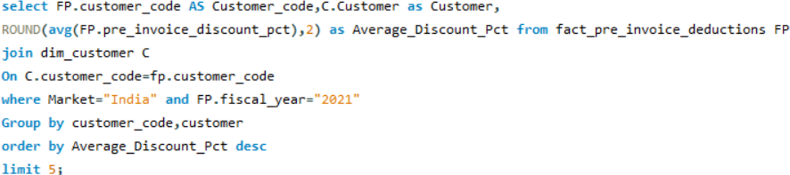
Generate a report which contains the top 5 customers who received an average high pre_invoice_discount_pct for the fiscal year 2021 and in the Indian market. The final output contains these fields, customer_code customer average_discount_percentage
#SQL QUERY
#RESULT
#INSIGHT
Top Average Pre_Invoice Discount% is for Flip Kart.
3 Largest E commerce platforms are in top 5

Slide 11
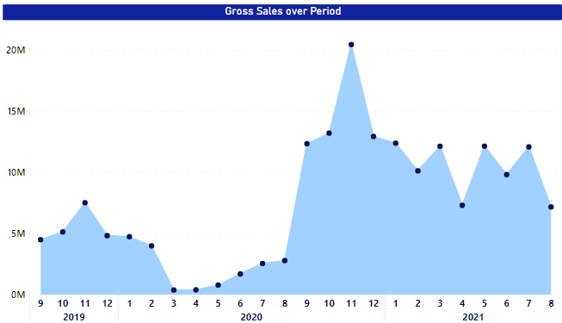
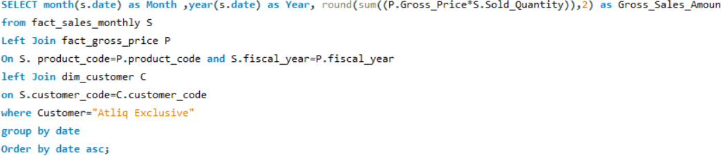
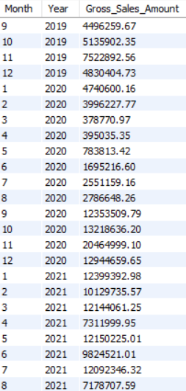
Get the complete report of the Gross sales amount for the customer “Atliq Exclusive” for each month. This analysis helps to get an idea of low and high-performing months and take strategic decisions.The final report contains these columns: Month Year Gross sales Amount
#SQL QUERY
#RESULT
#INSIGHT
Steady growth in 2020 followed by high fluctuation thereafter within 7 to 12 M.
Highest Sales achieved on November 2020, which is a festive season in INDIA.
Need to prepare the Inventory for the 2021 Festive season as the season sales is 8x normal sales.

Slide 12
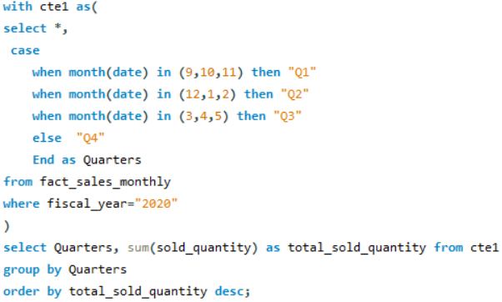
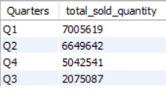
In which quarter of 2020, got the maximum total_sold_quantity? The final output contains these fields sorted by the total_sold_quantity, Quarter total_sold_quantity
#SQL QUERY
#RESULT
#INSIGHT
Steepest decline in Qty in Q3 and revamped after that.

Slide 13
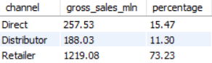
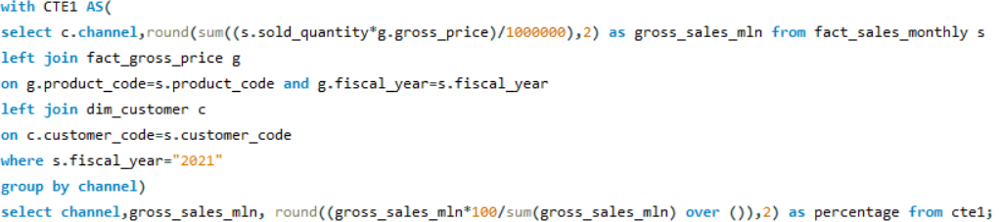
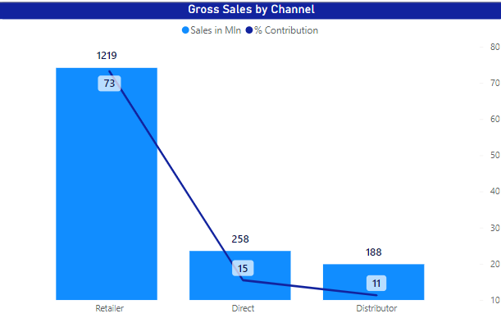
Which channel helped to bring more gross sales in the fiscal year 2021 and the percentage of contribution? The final output contains these fields, channel gross_sales_mln percentage
#SQL QUERY
#RESULT
#INSIGHT
Retailers Contributes 3/4th of Sales in 2021.
Need to focus more on Direct Sales as it increases profit.

Slide 14
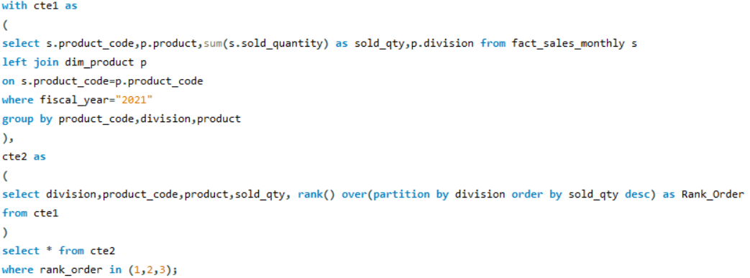
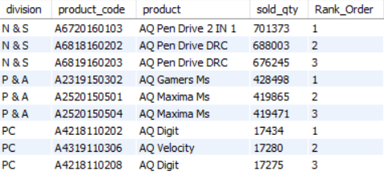
Get the Top 3 products in each division that have a high total_sold_quantity in the fiscal_year 2021? The final output contains fields, division product_code product total_sold_quantity rank_order
#SQL QUERY
#RESULT

Slide 15

Conclusion
Thanks to your commitment and strong work ethic, we know next year will be even better than the last.
We look forward to working together.

